Slide 1


Selenium With Java OPPS
SAROWER AHMMED
Senior Automation Engineer
Cegargate technology, CT

Slide 2
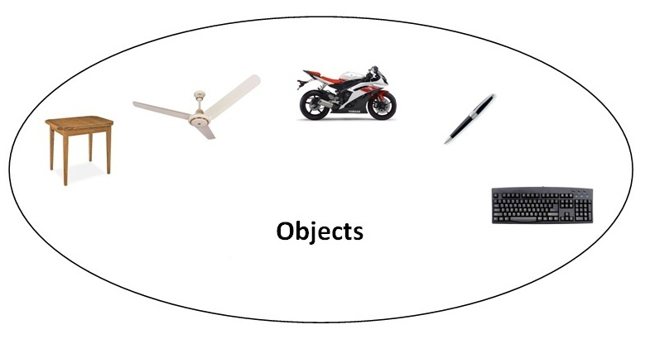
Object
Any entity that has state and behavior is known as an object. For example: chair, pen, table, keyboard, bike etc. It can be physical and logical.

Slide 3

Object
Object means a real word entity such as pen, chair, table etc.
Object-Oriented Programming is a methodology or paradigm to design a program using classes and objects.
It simplifies some concepts:
Object
Class
Inheritance
Polymorphism
Abstraction
Encapsulation
Interface
Constructor

Slide 4
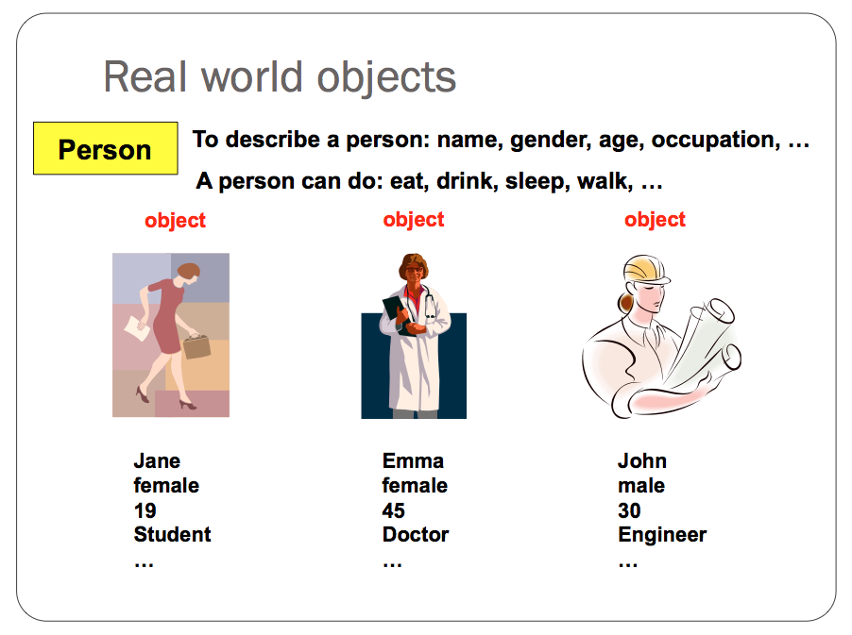

Slide 5
An object has three characteristics:
State: represents data (value) of an object.
Behavior: represents the behavior (functionality) of an object such as deposit, withdraw etc.
Identity: Object identity is typically implemented via a unique ID. The value of the ID is not visible to the external user. But, it is used internally by the JVM to identify each object uniquely.

Slide 6
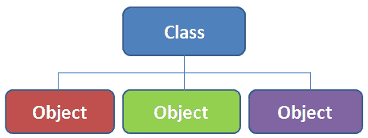
Class
Collection of objects is called class. It is a logical entity.
Its blue print of objects
It is a logical entity.
It can't be physical.

Slide 7
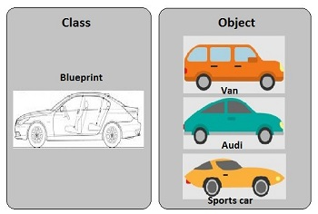

Slide 8
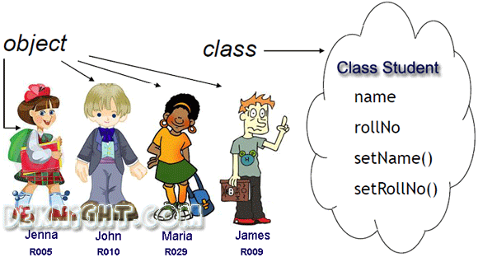

Slide 9
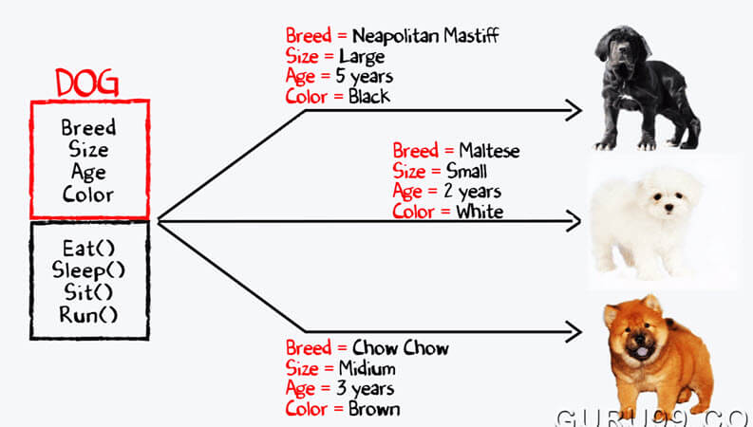

Slide 10

Object
Have some common criteria

Slide 11
Difference between object and class
OBJECT | CLASS
Object is an instance of a class | Class is a blueprint or template from which objects are created.
Object is a real world entity such as pen, laptop, mobile, bed, keyboard, mouse, chair etc. | Class is a group of similar objects.
Object is a physical entity. | Class is a logical entity.
Object is created through new keyword mainly e.g. Student boy=new Student(); | Class is declared using class keyword e.g. class Student{}
Object is created many times as per requirement. | Class is declared once.
Object allocates memory when it is created. | Class doesn't allocated memory when it is created.
There are many ways to create object in java such as new keyword, newInstance() method, clone() method, factory method and deserialization. | There is only one way to define class in java using class keyword.

Slide 12
What are the different ways to create an object in Java?
There are many ways to create an object in java. They are:
By new keyword
By newInstance() method
By clone() method
By deserialization
By factory method etc.

Slide 13
How to create object from class
Student girl= new Student();
Student boy= new Student();

Slide 14
Class Animal{
Animal dog = new Animal();
}
Class Vehicle{
Vehicle truck=new Vehicle();
}

Slide 15
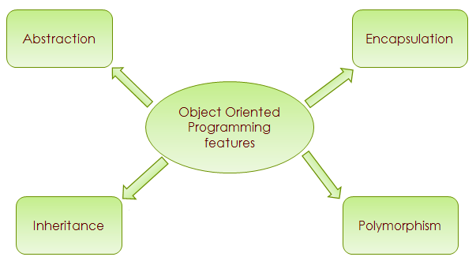

Slide 16
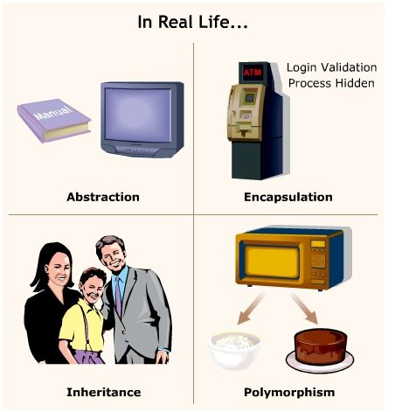

Slide 17
Inheritance in JAVA

Slide 18
Inheritance
Parent ➔ child
like common Genetic code transfer from parent or grant parent to child
Like getting properties from parent to child
Same :
Class A ➔extends➔ Class B ➔ extends ➔ Class C

Slide 19
//save by A.java
package pack;
public class A{
protected void msg(){System.out.println("Hello");}
}
//save by B.java
package mypack;
import pack.*;
class B extends A{
public static void main(String args[]){
B obj = new B();
obj.msg();
}
}
Output:Hello

Slide 20
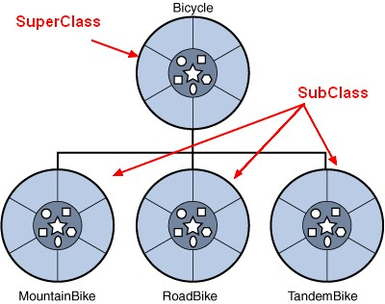
Super class and Sub class ??
1st class/ main class/parent class- called SUPER class
Extended class/2nd class/child class- called SUB class

Slide 21
Rules of inheritance in Java
1st child class/ sub class
Use extends key word
Parent class /super class
Parent class contains common properties
Child class will use all common properties inside parent class methods

Slide 22
Inheritance type
Single level : class A extends class B
Multi level:
class A extends class B
class B extends class C
Multiple – java don’t allow multiple inheritance but we can do it by interface
class A extends class B , class c

Slide 23
Why java need inheritance?
To use common properties form one class to other classes

Slide 24
Where you use inheritance in your current project?
I created base class with login information
Than I extends with other test cases class for login

Slide 25
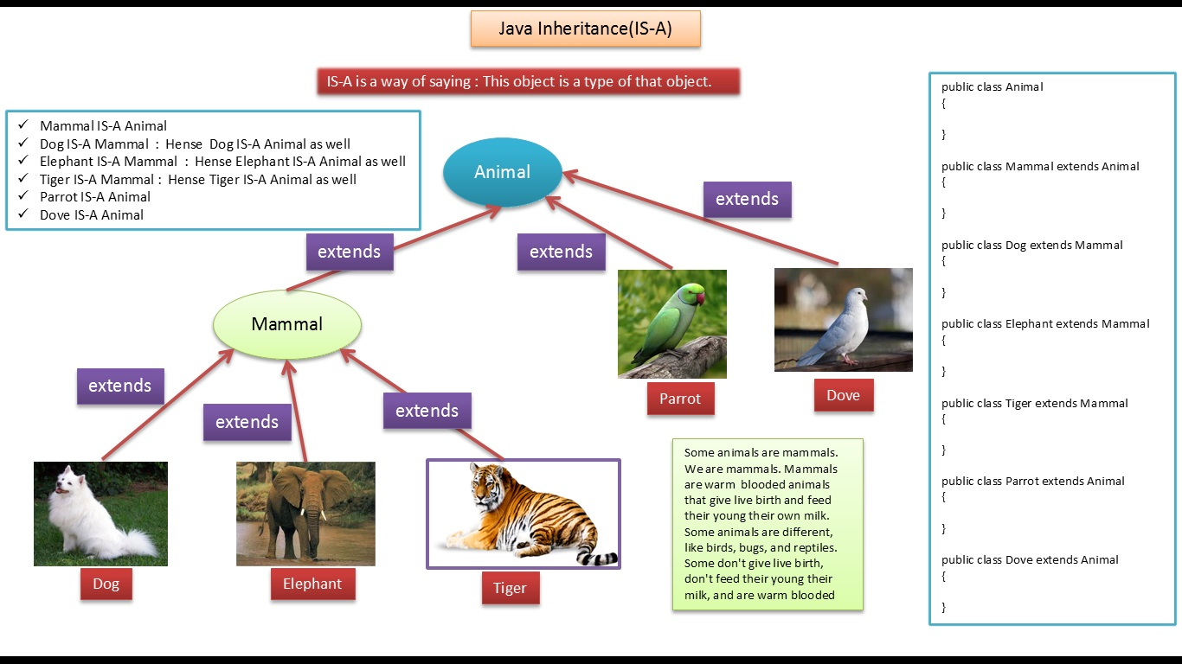

Slide 26
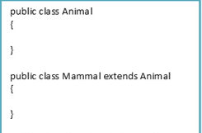
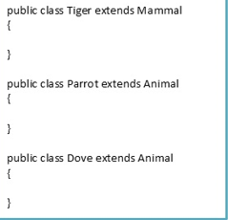
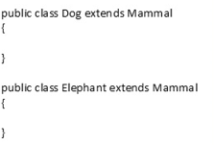

Slide 27
Inheritance
class Account {
// member declarations }
class SavingsAccount extends Account {
// inherit accessible members from Account // provide own member declarations }

Slide 28

Abstraction in Java
Abstraction is a process of hiding the implementation details and showing only functionality to the user.

Slide 29

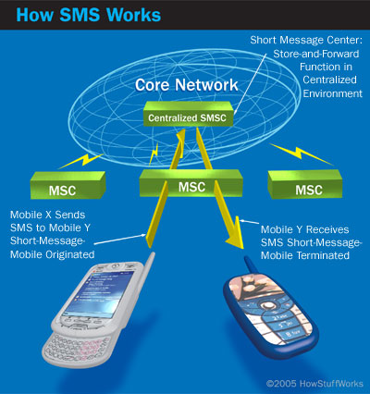
it shows only important things to the user and hides the internal details

Slide 30

Abstraction lets you focus on what the object does instead of how it does it

Slide 31


Slide 32
Why java need Abstraction ?
Hiding the implementation details and showing only functionality to the user.

Slide 33
Ways to achieve Abstraction in java
There are two ways to achieve abstraction in java
Abstract class (0 to 100%)
Interface (100%)

Slide 34
Rule of abstraction in java
Use abstract class (use abstract word before class name)
Abstract class contain abstract or non-abstract method
Use interface (contain only incomplete or abstract method)
Must be inheritance(extends) –abstract class to other class and complete abstract class
Must be implement interface to another class to complete abstract method in side interface

Slide 35
Abstraction vs Inheritance
Points | Abstraction | Inheritance
Class | Abstract class | Concrete class
Method | Abstract or non-abstract method | non-abstract method
Create object / instantiation | Can not instantiation of same class(no object creation) | Possible
Why java need? | Hiding detailed implementation | Getting propertied from parent to child class
Dependency | If Abstract class or abstract method- must inherited and complete the class and methods | If we want to get parent properties to child than need inheritance
How to do in java | By Abstract class and interface | By using extends word

Slide 36
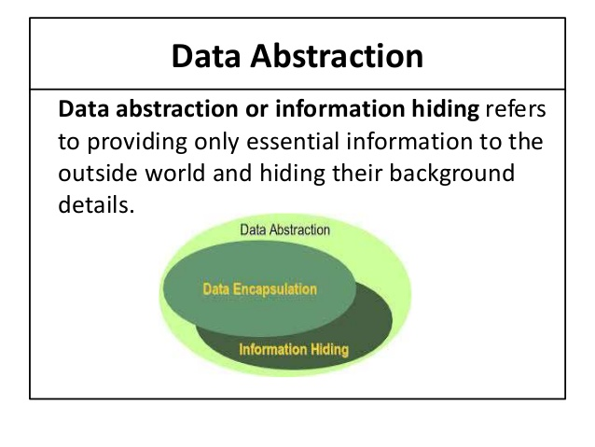

Slide 37
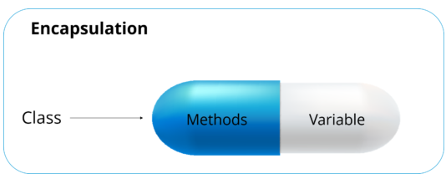
Encapsulation
Protect the code from outside world.

Slide 38

Abstraction lets you focus on what the object does instead of how does it work
Encapsulation hiding the code inside remote
And encapsulation

Slide 39
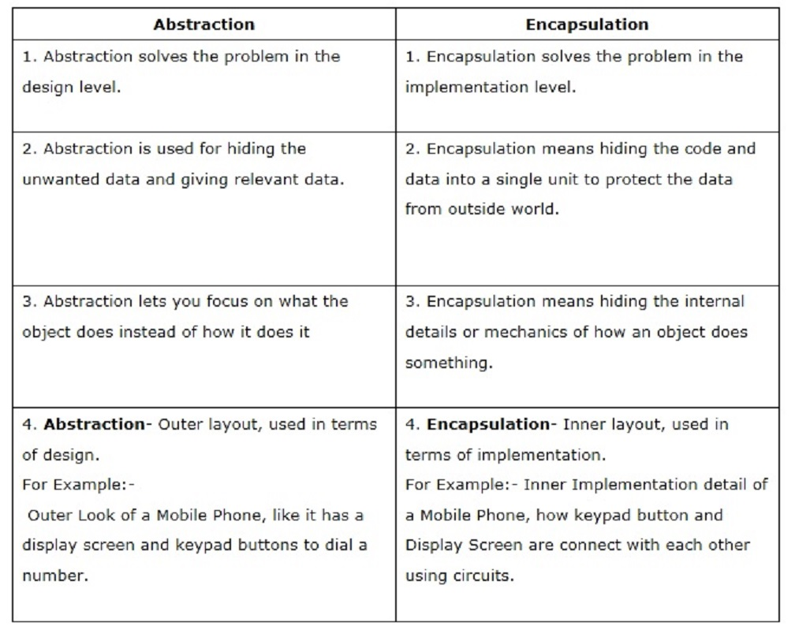

Slide 40
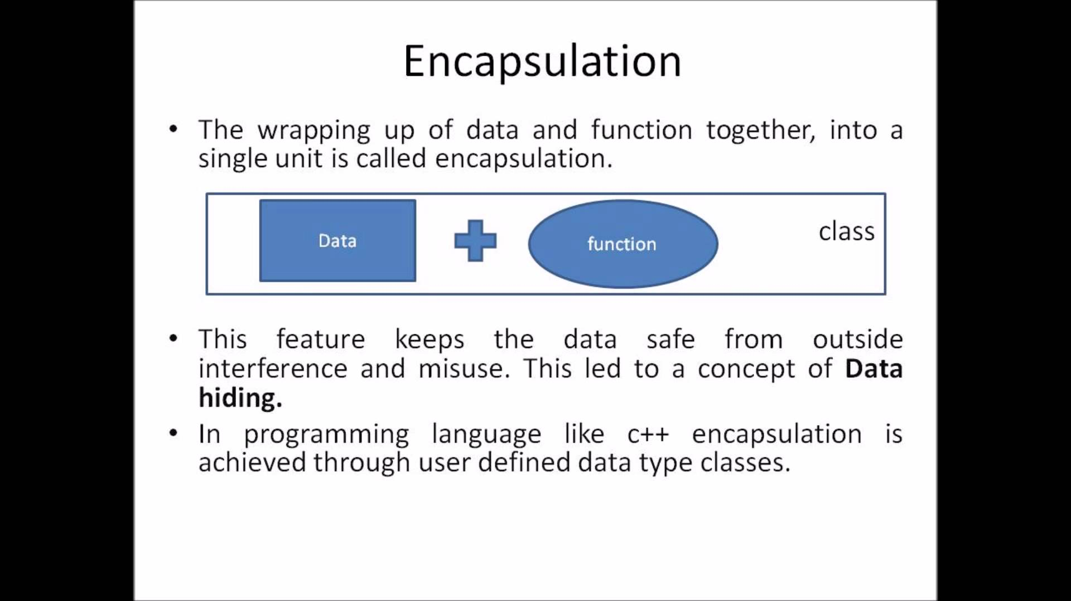

Slide 41
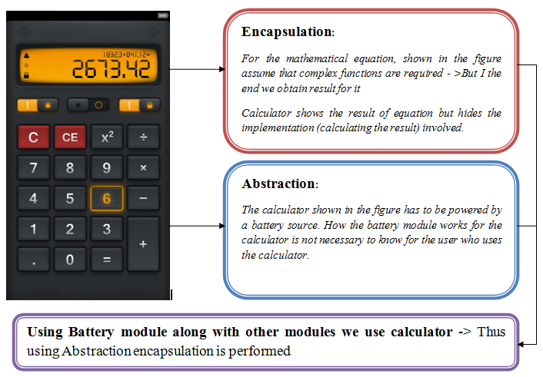

Slide 42
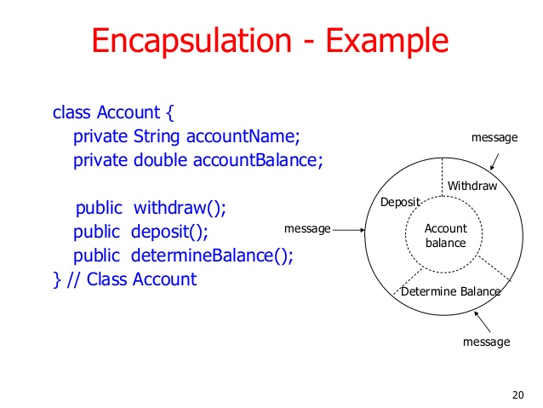

Slide 43
Rule of encapsulation
Variable must be private access modifier-No outside class can access private data member (variable) of other class.
Use public getter and setter methods to update -the private data fields/variable then the outside class can access those private data fields via public methods.
That’s why encapsulation is known as data hiding.

Slide 44
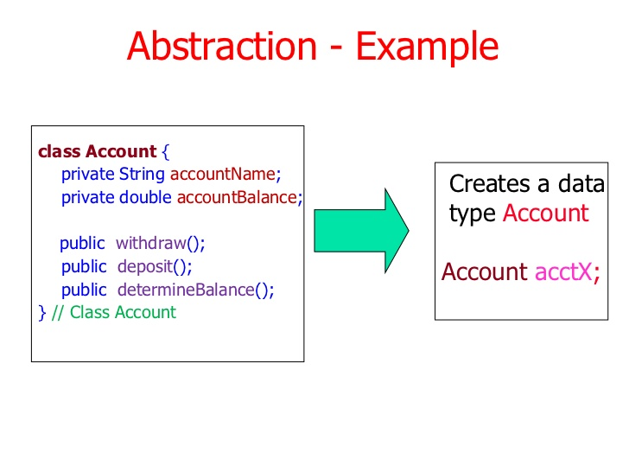
ENCAPSUALTION
CONSTRUCTOR

Slide 45
class Account {
private String name;
private long amount;
Account(String name, long amount) {
this.name = name;
setAmount(amount); }
void deposit(long amount) {
this.amount += amount;
}
String getName() {
return name;
}
long getAmount() {
return amount;
}
void setAmount(long amount) {
this.amount = amount; }
}

Slide 46
class SavingsAccount extends Account {
SavingsAccount(long amount) {
super(“saving", amount);
}
void withdraw(long amount) {
setAmount(getAmount() - amount);
}
}
class CheckingAccount extends Account {
CheckingAccount(long amount) {
super("checking", amount);
}
void withdraw(long amount) {
setAmount(getAmount() - amount);
}
}

Slide 47
class AccountDemo {
public static void main(String[] args) {
SavingsAccount sa = new SavingsAccount(10000);
System.out.println("account name: " + sa.getName());
System.out.println("initial amount: " + sa.getAmount()); sa.deposit(5000);
System.out.println("new amount after deposit: " + sa.getAmount());
CheckingAccount ca = new CheckingAccount(20000);
System.out.println("account name: " + ca.getName());
System.out.println("initial amount: " + ca.getAmount()); ca.deposit(6000);
System.out.println("new amount after deposit: " + ca.getAmount()); ca.withdraw(3000);
System.out.println("new amount after withdrawal: " + ca.getAmount()); } }

Slide 48
More code for Encapsulation
public int getEmpAge(){
return empAge;
}
public void setEmpAge(int newValue){
empAge = newValue;
}
public void setEmpName(String newValue){
empName = newValue;
}
public void setEmpSSN(int newValue){
ssn = newValue;
}
}
public class EncapsulationDemo{
private int ssn;
private String empName;
private int empAge;
//Getter and Setter methods
public int getEmpSSN(){
return ssn;
}
public String getEmpName(){
return empName;
}

Slide 49
Create another class and main method to run code
public class EncapsTesting{
public static void main(String args[]){
EncapsulationDemo obj = new EncapsulationDemo();
obj.setEmpName("Mario");
obj.setEmpAge(32);
obj.setEmpSSN(112233);
System.out.println("Employee Name: " + obj.getEmpName());

Slide 50
Interface in Java

Slide 51
Interface in Java
An interface is a reference type, similar to a class, which can be declared by using interface keyword,
An interface in java is a blueprint of a class. It has static constants and abstract methods.
Java Interface also represents IS-A relationship.
It cannot be instantiated just like abstract class.

Slide 52
Why use Java interface?
There are mainly three reasons to use interface. They are given below.
It is used to achieve abstraction.
By interface, we can support the functionality of multiple inheritance.
It can be used to achieve loose coupling.

Slide 53
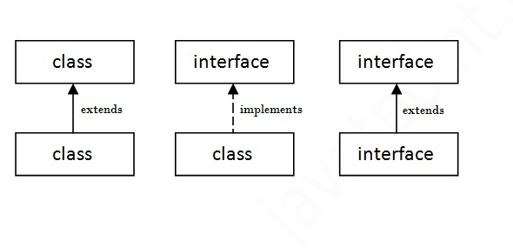

Slide 54
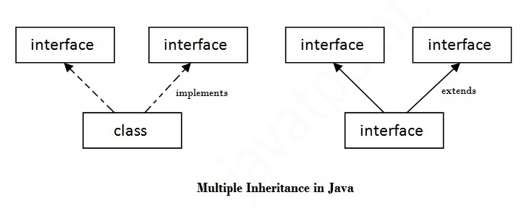

Slide 55
Interfaces have the following properties −
An interface is implicitly abstract. You do not need to use the abstract keyword while declaring an interface.
Each method in an interface is also implicitly abstract, so the abstract keyword is not needed.
Methods in an interface are implicitly public.

Slide 56
How interface looks like in java
interface Animal {
public void eat();
public void travel();
}

Slide 57
KEY WORD - Interface
Need to be implements to
another class to complete
methods body.
public class Dog implements Animal {
public void eat() {
System.out.println(“Dog can eats");
}
public void travel() {
System.out.println(“Dog can run");
}
public int numberOfLegs() {
return 0; }
public static void main(String args[]) {
Dog obj = new Dog();
obj.eat();
obj.travel(); } }
interface Animal {
public void eat();
public void run();
}

Slide 58
Java 8 Interface Improvement
Since Java 8, interface can have default and static methods

Slide 59
Java Interface Rules:
Interface fields are public, static and final by default, and
methods are public and abstract.

Slide 62
Difference between abstract class and interface
Abstract class | Interface
1) Abstract class can have abstract and non-abstract methods. | Interface can have only abstract methods. Since Java 8, it can have default and static methods also.
2) Abstract class doesn't support multiple inheritance. | Interface supports multiple inheritance.
3) Abstract class can have final, non-final, static and non-static variables. | Interface has only static and final variables.
4) Abstract class can provide the implementation of interface. | Interface can't provide the implementation of abstract class.
5) The abstract keyword is used to declare abstract class. | The interface keyword is used to declare interface.
6) Example: public abstract class Shape{ public abstract void draw(); } | Example: public interface Drawable{ void draw(); }

Slide 63
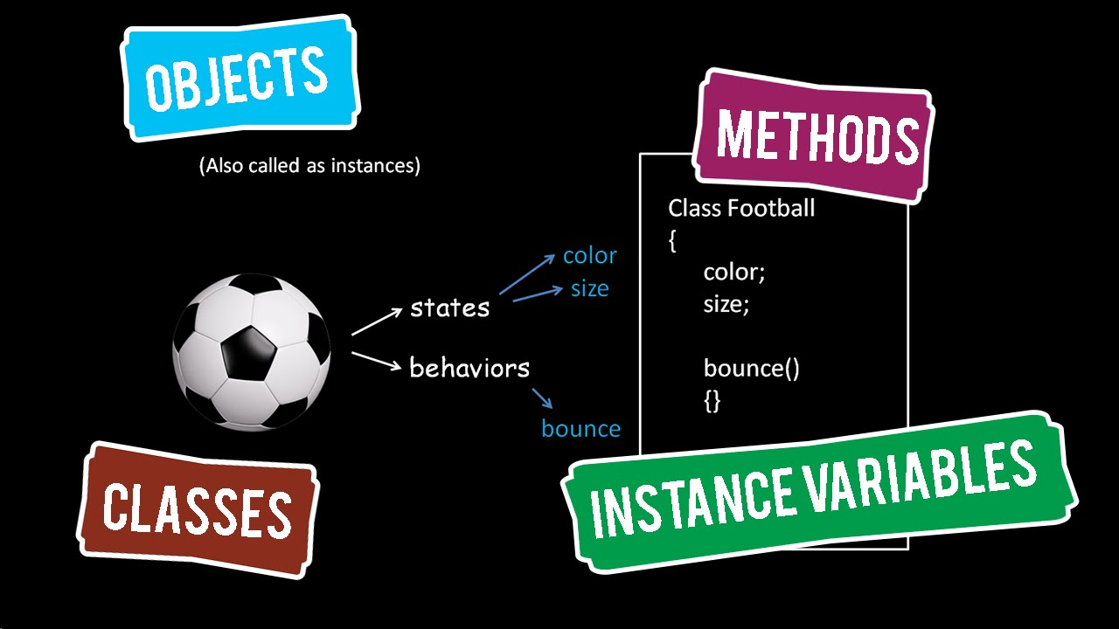
Methods

Slide 64
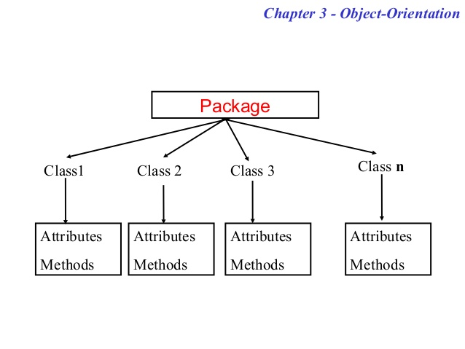

Slide 65
public Class Student{
Int age;
String name;
Public void running(){
age=10;
name= sarower;
Student boy =new student();
}
}

Slide 66
Types of Method | Why name | Static variable | Non -static/instance variable | class
Static Method | Static word used | Yes | No | Normal
No static Method | No Static | Yes | Yes | Normal
Void /return nothing | Void word | Yes | Yes | Normal
Non-Void/return something | No void | Yes | Yes | Normal
Main Methods | Static void main | Yes | No | JVM only run main method
Abstract method | No inside description | Nothing inside as no description | Nothing inside | Abstract class

Slide 67
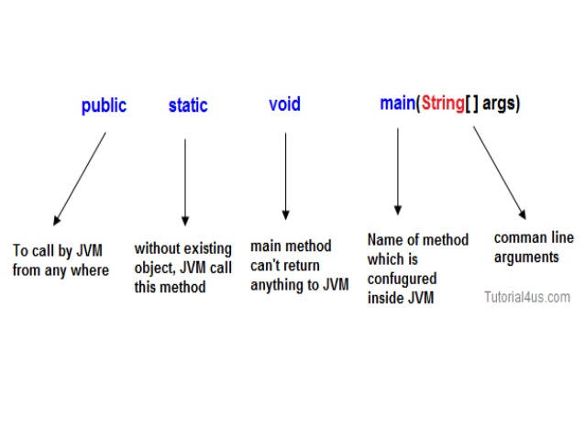

Slide 68
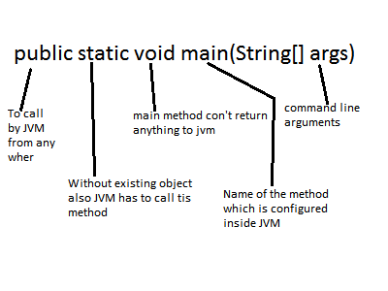

Slide 69
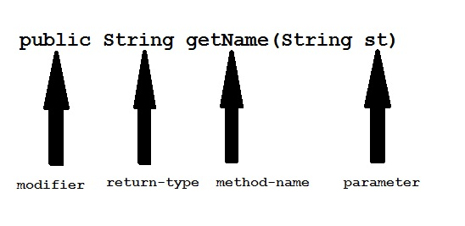

Slide 70
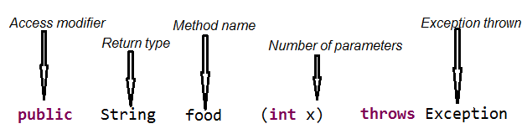

Slide 72
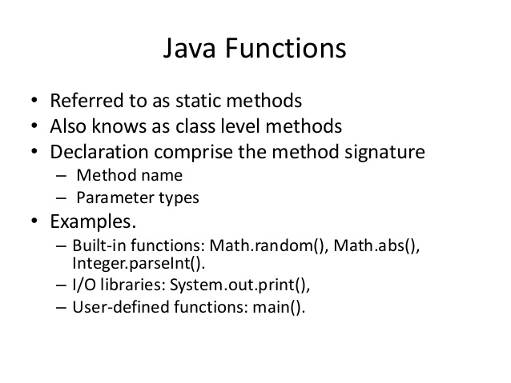

Slide 73
Static Methods
he static keyword in java is used for memory management mainly. We can apply java static keyword with variables, methods, blocks and nested class. The static keyword belongs to the class than instance of the class.
The static can be:
variable (also known as class variable)
method (also known as class method)
block
nested class

Slide 74
Java static method
If you apply static keyword with any method, it is known as static method.
A static method belongs to the class rather than object of a class.
A static method can be invoked without the need for creating an instance of a class.
static method can access static data member and can change the value of it.

Slide 75
Restrictions for static method
There are two main restrictions for the static method. They are:
The static method can not use non static data member or call non-static method directly. this and super cannot be used in static context.
class A{
int a=40;//non static
public static void main(String args[]){
System.out.println(a);
}
}
Test it Now
Output:Compile Time Error

Slide 76
Q) why java main method is static?
because object is not required to call static method if it were non-static method, jvm create object first then call main() method that will lead the problem of extra memory allocation
Since the main method is static Java virtual Machine can call it without creating any instance of a class which contains the main method.
4. Anything which is declared in class in Java comes under reference type and requires object to be created before using them but static method and static data are loaded into separate memory inside JVM called context which is created when a class is loaded. If main method is static than it will be loaded in JVM context and are available to execution

Slide 77
Why main method is public in Java
Any method or variable which is declared public in Java can be accessible from outside of that class. Since the main method is public in
Java, JVM can easily access and execute it.

Slide 78
Why the main method is void in Java Since the main method in Java is not supposed to return any value, it's made void which simply means main is not returning anything. Summary: 1. The main method must be declared public, static and void in Java otherwise, JVM will not able to run Java program.

Slide 79
Java static block
Is used to initialize the static data member.
It is executed before main method at the time of classloading.
Example of static block
class A2{
static{System.out.println("static block is invoked");}
public static void main(String args[]){
System.out.println("Hello main");
}
}
Test it Now
Output:static block is invoked Hello main

Slide 80
We can use testing or junit - @ test annotation and replace main methods
Can we execute a program without main() method?
Ans) Yes, one of the way is static block but in previous version of JDK not in JDK 1.7.
class A3{
static{
System.out.println("static block is invoked");
System.exit(0);
}
}
Test it Now
Output:static block is invoked (if not JDK7)
In JDK7 and above, output will be:
Output:Error: Main method not found in class A3, please define the main method as:
public static void main(String[] args)

Slide 81
Abstract class in Java
Abstract mean incomplete
A class that is declared with abstract keyword, is known as abstract class in java. It can have abstract and non-abstract methods (method with body).
Before learning java abstract class, let's understand the abstraction in java first.

Slide 82
Abstract method
Nothing inside the method name as no description
Only method signature present buy no body or description.
The class which contain a abstract method is called abstract class
The word abstract means incomplete
Abstract class must be extend another class and incomplete/abstract method must be complete……..other wise 2nd class will be abstract too as method not complete

Slide 83
Polymorphism in java

Slide 84
Polymorphism in java
The word ‘polymorphism’ literally means ‘a state of having many shapes’ or ‘the capacity to take on different forms’.
Poly means many
Morphism means form or structure
Where to use different form/ polymorphism in java –
Methods
constructor

Slide 85
Polymorphism in Java has two types
Method overloading or Compile time polymorphism (static binding) and
method overriding or Runtime polymorphism (dynamic binding).
Overloading in method level
Overriding in class level

Slide 86

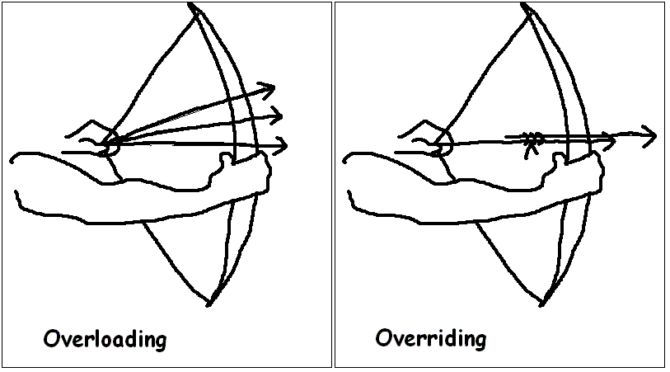


Overloading vs Overriding

Slide 87
Overloading or Compile time - criteria's
Overloading criteria or Compile time
Inside one class only
Same method or constructor name/signature
But only parameter change
Static and non static both method can use this
Only one Class, so no need inheritance of class

Slide 88
Example of method overloading polymorphism
class Calculation {
void sum(int a){
System.out.println(a);
}
void sum(int a,int b){
System.out.println(a+b);
}
void sum(int a,int b,int c){
System.out.println(a+b+c);
}
public static void main(String args[]) {
Calculation obj=new Calculation();
obj.sum(5); //5
obj.sum(20,20); //40
obj.sum(10,10,10); // 30
}
}
In such scenario, compiler is able to figure out the method call at compile-time that’s the reason it is known as compile time polymorphism.

Slide 89
Dynamic Polymorphism or runtime polymorphism or Overriding:
Criteria in java
Need at least two class (Child class extands parent class)
Use parent class same method name / signature in child class
But method parameter also same
Only body description will change
Static method no need overriding or overriding not possible
Constructor can not do overriding

Slide 90
Usage of Java Method Overriding
Method overriding is used to provide specific implementation of a method that is already provided by its super class.
Method overriding is used for runtime polymorphism

Slide 91
Rules for Java Method Overriding
method must have same name as in the parent class
method must have same parameter as in the parent class.
Parent class must inheritance in child class

Slide 92
Can we override static method?
No, static method cannot be overridden. It can be proved by runtime polymorphism, so we will learn it later.
Why we cannot override static method?
because static method is bound with class whereas instance method is bound with object. Static belongs to class area and instance belongs to heap area.

Slide 93
Can we override java main method?
No, because main is a static method.

Slide 94
Method Overloading | Method Overriding
Method overloading is used to increase the readability of the program. | Method overriding is used to provide the specific implementation of the method that is already provided by its super class.
Method overloading is performed within class. | Method overriding occurs in two classes that have IS-A (inheritance) relationship.
In case of method overloading, parameter must be different. | In case of method overriding, parameter must be same.
Method overloading is the example of compile time polymorphism. | Method overriding is the example of run time polymorphism.
In java, method overloading can't be performed by changing return type of the method only. Return type can be same or different in method overloading. But you must have to change the parameter. | Return type must be same or covariant in method overriding.

Slide 95
Java access modifiers with method overriding
If you are overriding any method, overridden method (i.e. declared in subclass) must not be more restrictive.
The default modifier is more restrictive than protected. That is why there is compile time error.
class A{
protected void msg(){System.out.println("Hello java");}
}
public class Simple extends A{
void msg(){System.out.println("Hello java");}//C.T.Error
public static void main(String args[]){
Simple obj=new Simple();
obj.msg();
}
}

Slide 96
Real example of Java Method Overriding
Consider a scenario, Bank is a class that provides functionality to get rate of interest. But, rate of interest varies according to banks. For example, SBI, ICICI and AXIS banks could provide 8%, 7% and 9% rate of interest.
Java method overriding example of bank

Slide 97
Method overriding need inheritance
CHEASE
BANKOFAMERICA
CITY BANK

Slide 98
public class FEDRALBANK{
public int getRateOfInterest(int a){
return a;
}}
public class CHEASEBANK extends FEDRALBANK{
public int getRateOfInterest(int a){
System.out.println("CHEASEBANK Interest is ::"+a);
return a;
}}
public class BankOfAmerica {
public int getRateOfInterest(int a){
System.out.println("BankOfAmerica Interest is ::"+a);
return a;
}}

Slide 99
public class Test {
public static void main(String[] args) {
CHEASEBANK obj=new CHEASEBANK();
obj.getRateOfInterest(5);
BankOfAmerica obj1=new BankOfAmerica();
obj1.getRateOfInterest(7);
}
}Test it Now
Output:
SBI Rate of Interest: 8
ICICI Rate of Interest: 7
AXIS Rate of Interest: 9

Slide 100
Overriding another example
}
}
class Vehicle{
public void move(){
System.out.println(“Vehicles can move!!”);
}
}
class MotorBike extends Vehicle{
public void move(){
System.out.println(“MotorBike can move and accelerate too!!”);
}
}
class TestDemo{
public static void main(String[] args){
Vehicle vh=new MotorBike();
vh.move();
}
}

Slide 101
Why java need static method?
No need to create object to call this static method – from one class to another class.
Static methods are class level, so JVM call them with or after the class
Performance faster than non static method as
No need object creation to call this method
No need to overridden polymorphism
Poly morphism
Overloading – static and non static method
Overriding –only non static , not possible for static method

Slide 102
Constructor Overloading
If same Name constructor exists multiple times
in the same class with
different number of parameters or
order of parameters or
type of parameters
is known as Constructor overloading.
Why need- constructor overloading
can be used to initialize same or different objects with different values.

Slide 103
Same constructor name but parameter different- help to re use same code / constructor
class Demo {
Demo () {
Your code here
}
Demo (datatype1 value1) {
Your code here
}
Demo (datatype1 value1, datatype2 value2) {
Your code here
}
Demo (datatype2 variable2) {
Your code here
}
Demo (datatype2 value2, datatype1 value1) {
Your code here
}
Your code here
}

Slide 104
Why overriding is not possible at constructor level.
The scope of constructor is within the class
But overriding process happen outside of the class
So that it is not possible to achieved
No overriding at constructor level.

Slide 105
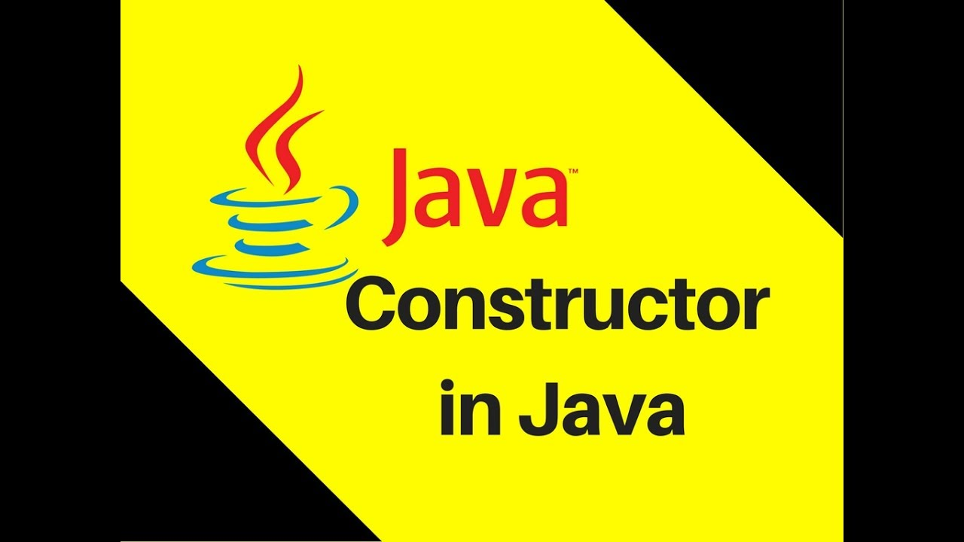


Slide 106
Constructor
Constructor in java is a special type of method that is used to initialize the object.
Java constructor is invoked at the time of object creation.
It constructs the values i.e. provides data for the object that is why it is known as constructor.

Slide 107

Contractor -construct value
Class
Create Object
Construct give Value in object state/ Variable

Slide 108
Why Java need Constructor?
Contractor eliminate default value and contract /put user input value
Default value in java:
Integer default value = 0
Double default value = 0.0
String default value = null
Driver default value = null
Why we need to remove default value?
String and driver default value null and java cant handle any null value
Null value will give you – null point exception
Constructor change these default value with user input value
Integer default value = 10
Double default value = 20.65
String default value = “sarower”
Driver default value = with URL

Slide 109
Also constructor help
Constructors are used to initialize the instances/object of your classes.
A constructor invoke automatically when a object is created
A class contains constructors that are invoked to create objects from the class blueprint
Initialization is a process of assigning user defined values at the time of allocation of memory space.

Slide 110
Rules for creating java constructor
Constructor name must be same as its class name
Constructor must have no explicit return type/ no void

Slide 111
What do Constructors look like in Code?
Here below Sum class has Sum() constructor
class Sum {
Sum() {
}
public static void main(String s[]) {
Sum s=new Sum();
}
}

Slide 112
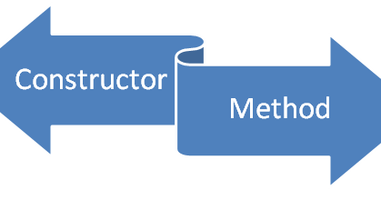
Is constructor like class or like method?
Constructor in Java is a special member like a method

Slide 113
POINTS | Java Constructor | Java Method
Purpose | Initialize the state of an object. | Expose behavior of an object.
Return type | No return type, not even void | void or a valid return type
Invoke | Constructor is invoked implicitly/ automatically | Method is invoked explicitly.
Default constructor | The JVM provides a default constructor if you don't have any constructor. | Method is not provided by compiler in any case.
Name | Constructor name must be same as the class name. | Method name may or may not be same as class name.
Modifiers | Cannot be abstract, final, native, static, or synchronized | Can be abstract, final, native, static, or synchronized
Inheritance | Constructors are not inherited | Methods are inherited
This words | This word to another constructor in the same class. If used, it must be the first line of the constructor | This Refers to an instance of the owning class. Cannot be used by static methods
Super words | Calls the constructor of the parent class. If used, must be the first line of the constructor | Calls an overridden method in the parent class

Slide 114
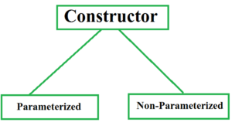
Types of java constructors
Default constructor (non-parameterized constructor)
Parameterized constructor/ argument constructor

Slide 115
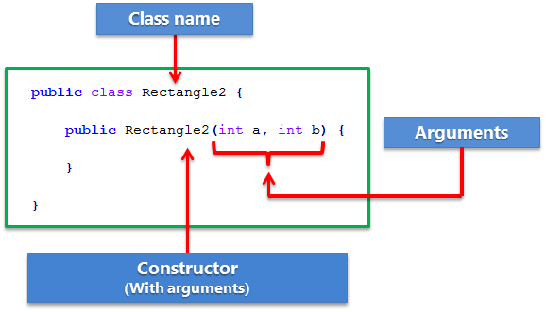
Constructor model in java: Same as object create from class
Same as class name , but it is like a method.
No void
If no parameter- Default
With parameter- Parameterized

Slide 116
Default constructor
A constructor that have no parameter is known as default constructor.
Even default constructor created by JVM if no constructor created.
It provide default value of variable/ obj state, like-
Int variable value=0
Double =0.0
String=null

Slide 117
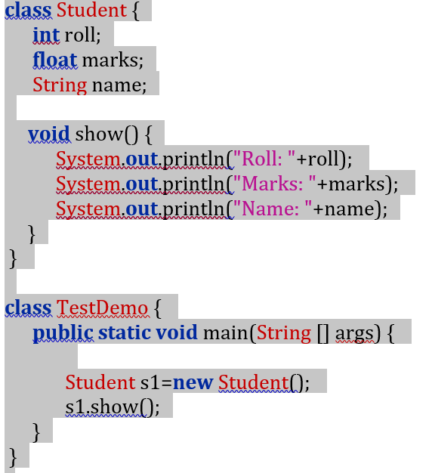
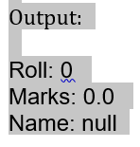
Example of default constructor that displays the default values:

Slide 118
How Constructor eliminates default values?
Same as variable initialization and remove default value

Slide 119
Parameterized constructor: If any constructor contain list of variable in its signature is known as parameterized constructor.

Slide 120
Constructor Overloading
A class can have any number of constructors that differ in parameter lists.
In general constructor overloading can be used to initialize same or different objects with different values.

Slide 121
Over loading of constructor

Slide 122
Why overriding is not possible at constructor level.
Overriding means extends parent class to child class and use same parent methods in child.
Constructor cant inherited from one class to another class
So Overriding of constructor not possible.

Slide 123

Brain capacity is beyond your imagination.
The more you use, the more brain cell will be active.
Otherwise laziness inactive your brain cell gradually.

